Slide 1
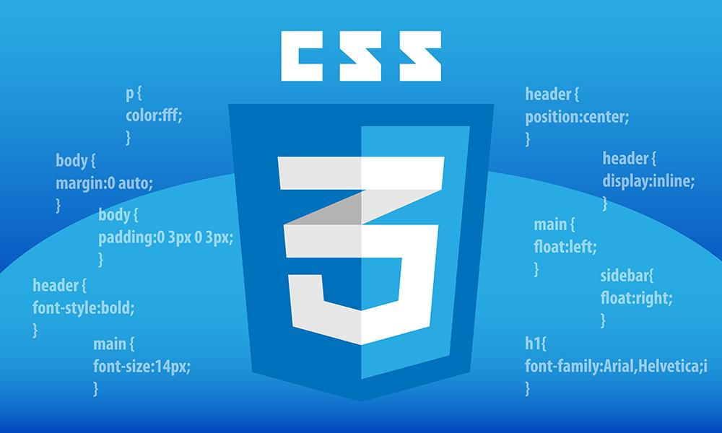

Slide 2
CSS- Cascading Style Sheets
CSS is a style sheet language used to describe the presentation of a document written in a markup language like HTML, XML.
CSS allows you to control the layout, color, font, and other visual aspects of a web page.
CSS applies styles using selectors, properties.
Selectors help to target/select the HTML element.
CSS properties are the names that identify the styles you want to apply, such as color, font-size, or margin.
Each property has a set of allowed values that determine the specific styling, like red, 16px, or auto.
History
CSS was developed by Håkon Wium Lie in 1994.
1998: CSS2 released.
1999 - 2011: CSS2.1 refinements.
1999 - Present: CSS3 modules developed and standardized.

Slide 3
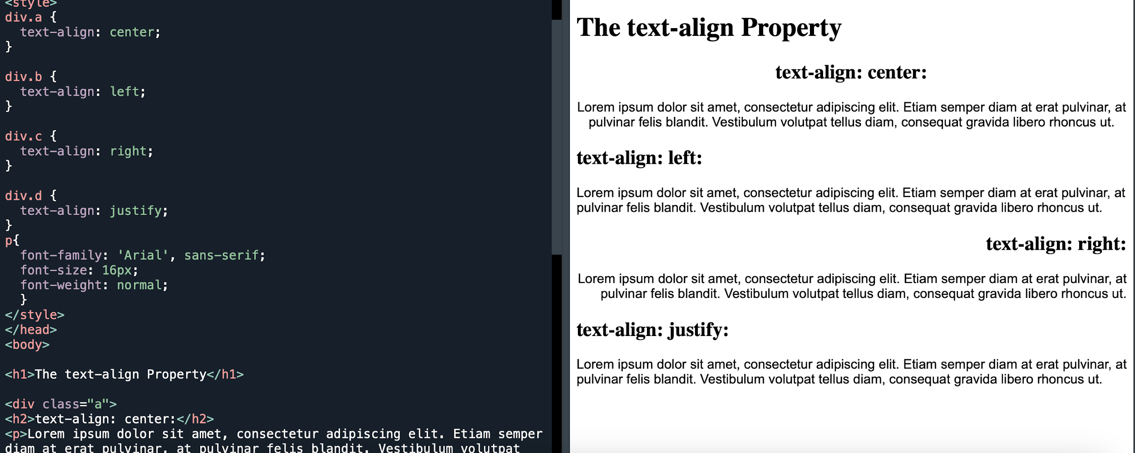
CSS Properties
Font
Text Alignment
Font property used to style related to font
Font, font-family, font-size, font-weight, font-style
Specifies the horizontal alignment of text within an element.
left: Aligns the text to the left.
right: Aligns the text to the right.
center: Centers the text.
justify: Stretches the lines so that each line has equal width, and the text is aligned along both the left and right margins.

Slide 4
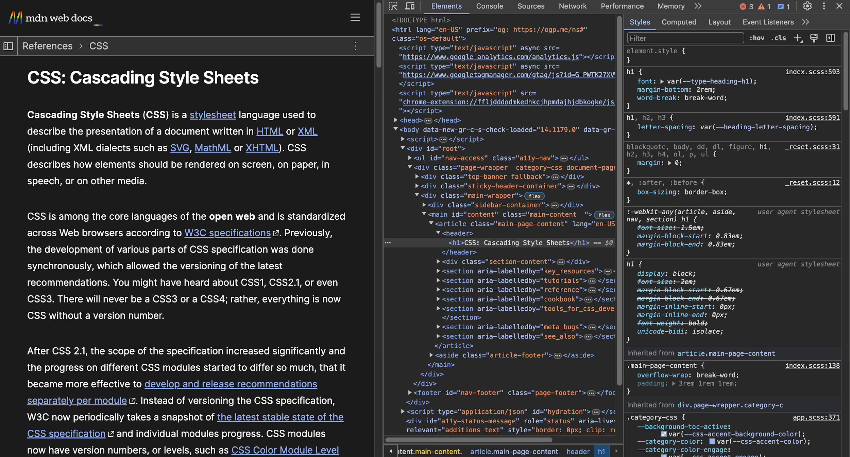
Inspection Mode
Inspecting web elements in a browser lets developers, designers, or digital marketers manipulate the appearance of a web page.
Helps to debug a particular element, conduct layout tests, or perform live CSS editing.
It allows web designers to instantly modify the CSS properties like fonts, sizes, colors, etc. to get a sense of how a web page would look if certain changes are made.
Changes made are local and reversed back when refreshed.

Slide 5
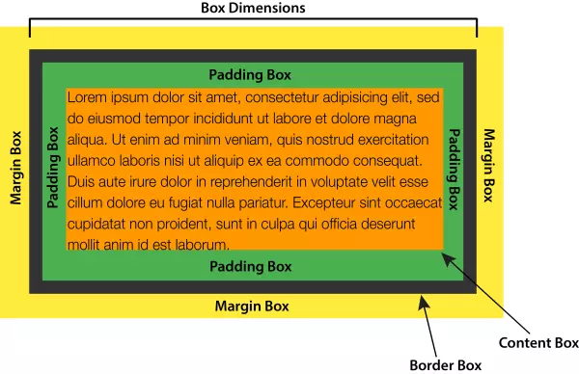
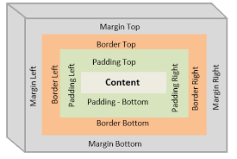
CSS Box Model
The term "box model" is used when talking about design and layout.
All HTML elements can be considered as boxes.
CSS box model is essentially a box that wraps around every HTML element.
It consists of content, padding, borders and margins.

Slide 6
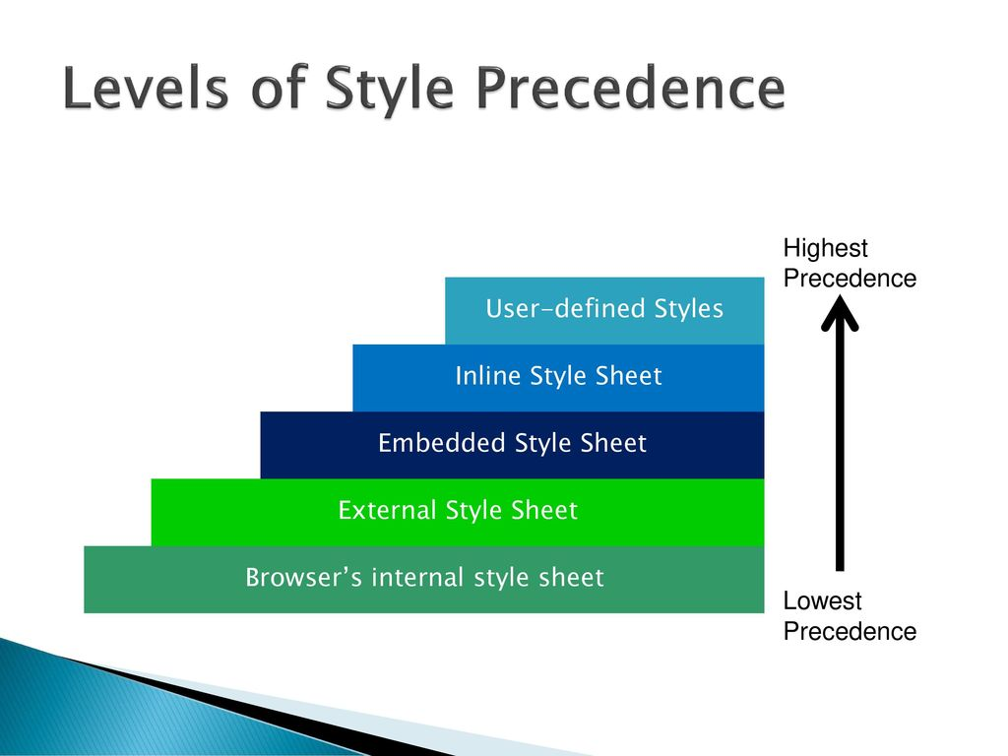
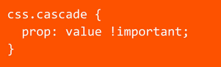
CSS Cascade
The process of determining which styles will be applied to an HTML element when multiple conflicting styles are present.
Position:
The style specified at last will take precedence.
Order of Precedence:
Inline Styles
Internal Styles
External Styles
Browser Defaults
Specificity:
Specificity determines which style rule takes precedence when multiple rules target the same element.
Id
Attribute
Class
List
!important Rule:
!important declaration overrides normal declaration weight.
It is recommended to use !important sparingly, as it can lead to specificity issues and make debugging more challenging.

Slide 7
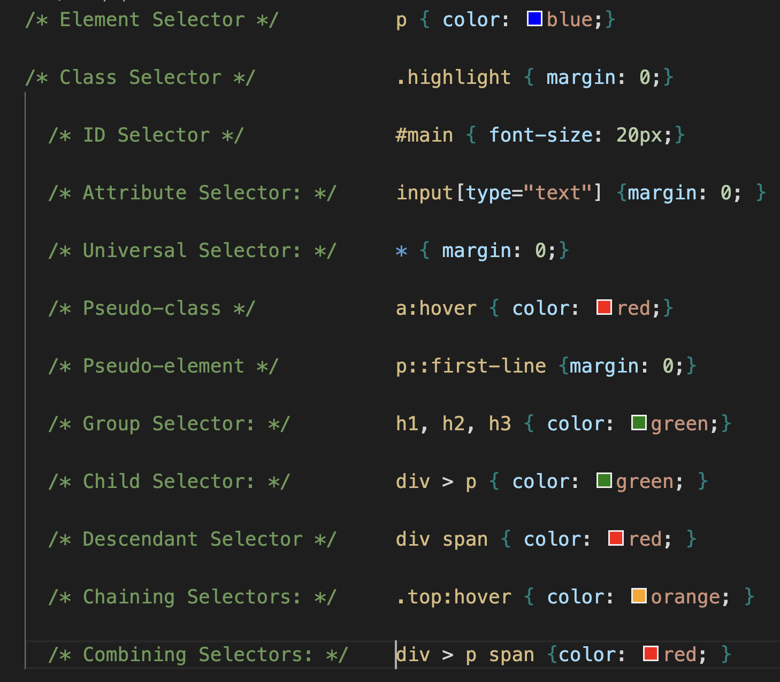
CSS Selectors
A CSS selector selects the HTML element(s) we want to style.
Element Selector: Selects elements based on their tag name.
Class Selector: Selects elements based on their class attribute.
ID Selector: Selects a single element based on its ID attribute.
Attribute Selector: Selects elements based on their attributes.
Universal Selector: Selects all elements in the document.
Pseudo-classes: Selects elements based on their state or position
Pseudo-elements: Selects specific parts of an element.
Group Selector: Groups multiple selectors together to apply the same styles to all selected elements.
Child Selector: The child selector selects elements that are direct children of a specified element. It uses the > combinator to target these direct child elements.
Descendant (Dependent) Selector: The descendant selector selects elements that are descendants of a specified element.
Chaining selectors: Combining multiple selectors to target elements more precisely..
Combining Selectors: You can combine child and descendant selectors to create more specific rules.

Slide 8
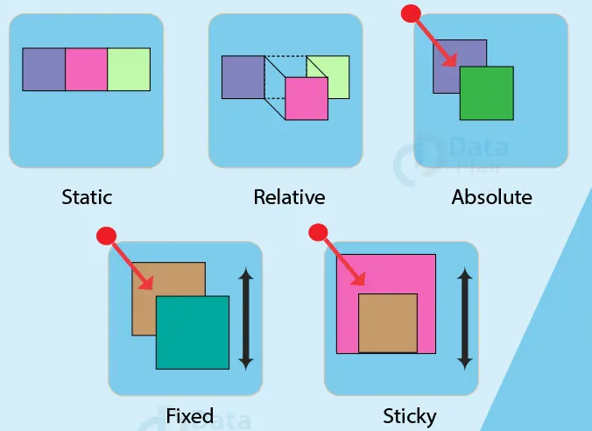
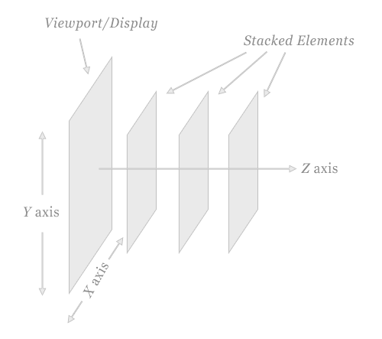
CSS Position
Used to specify the position for an element
1. Static Positioning:
Default positioning for all elements. Elements are positioned according to the normal flow of the document.
2.Relative Positioning
Positioned relative to its normal position. The top, right, bottom, and left properties will move the element from its original position.
3. Absolute Positioning
Element is positioned relative to its nearest positioned ancestor. If no such ancestor exists, it will be positioned relative root element.
4. Fixed Positioning
Element is positioned relative to the viewport, which means it always stays in the same place even if the page is scrolled.
5. Sticky Positioning
It will stick in place when it reaches a specified scroll position.
z-index
The z-index controls the vertical stacking order of elements that overlap.
An element with a higher z-index value will be displayed in front of elements with lower z-index values.

Slide 9
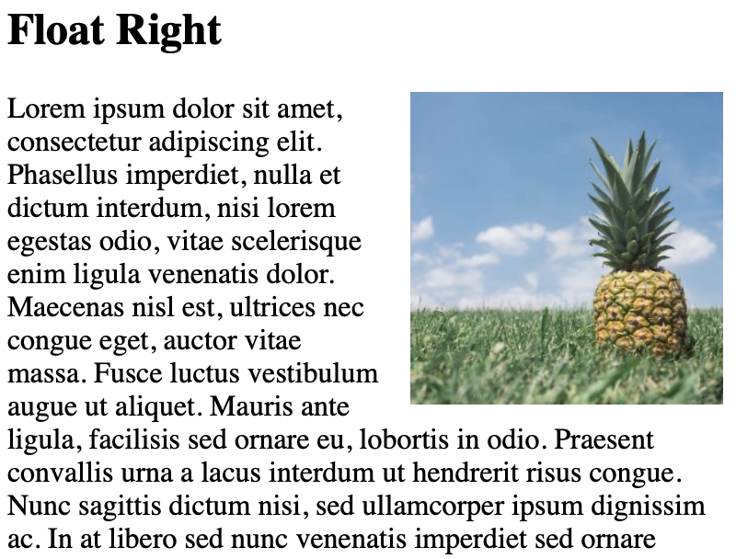
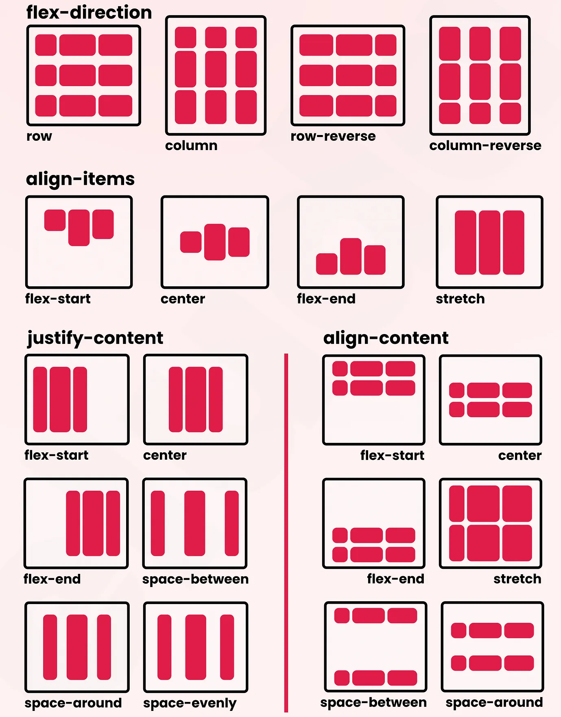
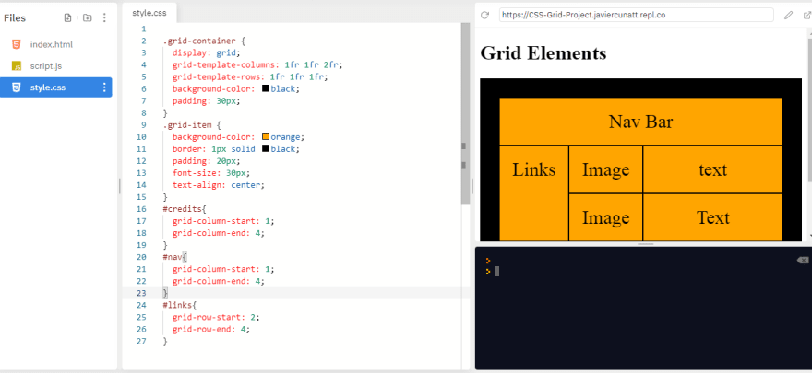
Layouts
Flexbox
A one-dimensional layout method
It arranges items in rows or columns and is used to specify the space between or around a group of items.
It is designed to achieve alignment and space distribution along a particular row or column direction.
Grid
Float
Two-dimensional layout (both rows and columns).
Control over both the horizontal and vertical alignment of items.
Easier to create complex layouts like grids, galleries, etc.
Used for positioning and formatting content
Float Properties:
Left, right, .none. Inherit
The clear property is used to control the behavior of the element that follows a floating element.
It ensures that the floating elements do not affect the layout of subsequent elements.

Slide 10

Responsive Design
It is an approach in web development that ensures web pages render well on a variety of devices and window or screen sizes.
It aims to provide an optimal viewing experience—easy reading and navigation with a minimum of resizing, panning, and scrolling—across a wide range of devices, from desktop computer monitors to mobile phones.
Key Points to Consider while Responsive Design
Use of percentages rather than fixed units like pixels.
Images that scale with the layout to ensure they don’t break the design or overflow their containing elements.
Media Queries.

Slide 11
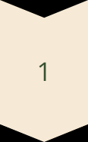
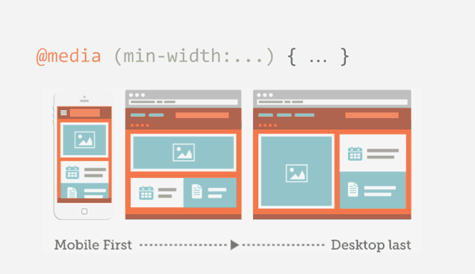
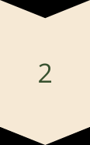
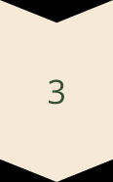
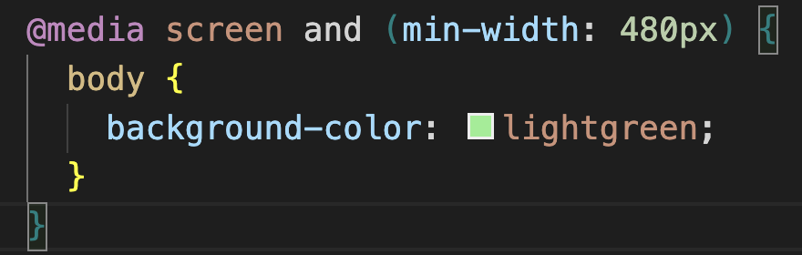
CSS Media Query
Responsive Design
CSS media queries allow you to create responsive web designs that adapt to different screen sizes, devices, and user preferences.
Breakpoints
Developers define breakpoints, or specific screen widths, to apply different CSS rules and layouts for optimal viewing.
Targeting Devices
Media queries can target a wide range of device characteristics, including screen resolution, aspect ratio, orientation, and even input type.

Slide 12
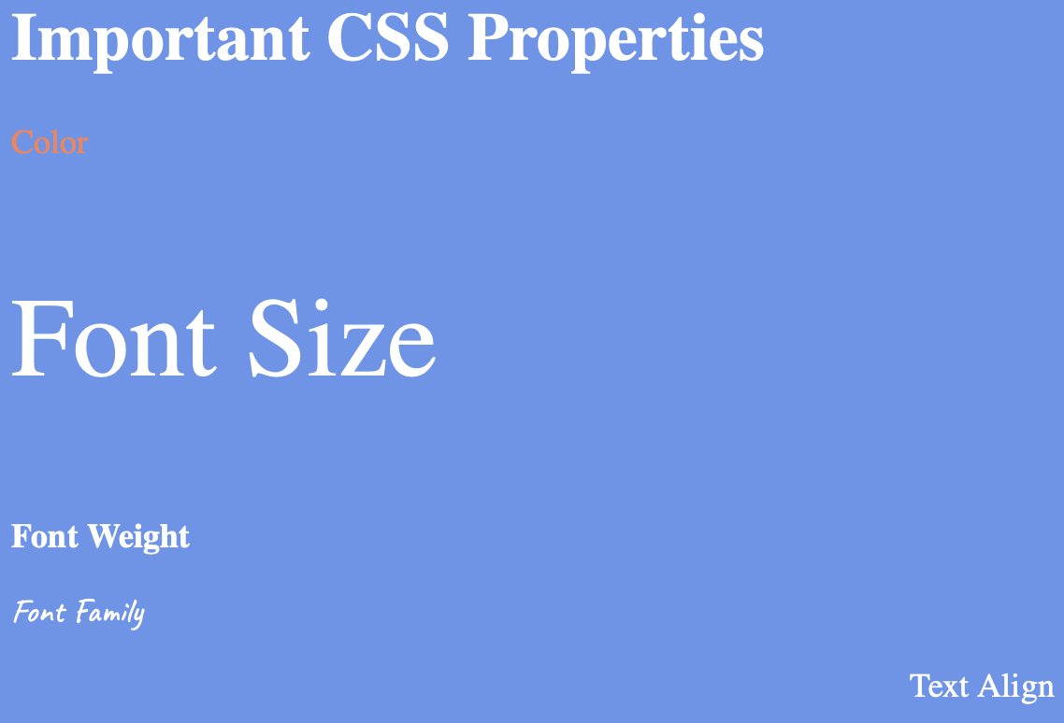
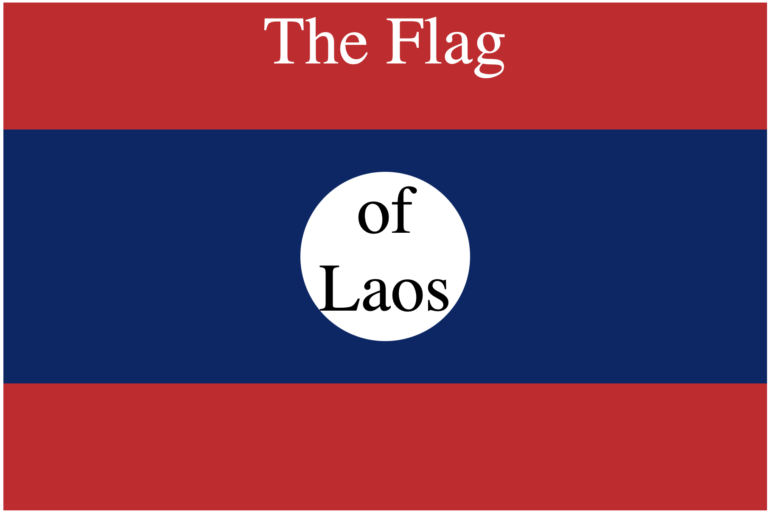
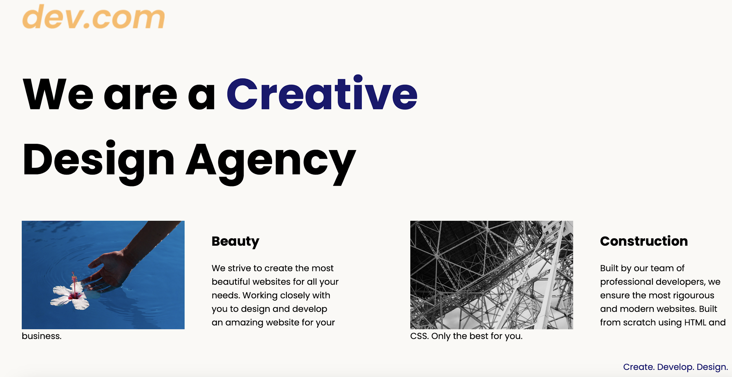

Slide 13
References
https://developer.mozilla.org/en-US/docs/Web/HTM
https://www.w3schools.com/html/

